Slide 1
Lecture 4 - Analytics
Ben.Lackey@DataStax.com
Partner Architect
+1 720 933 9852
@benofben

Slide 2
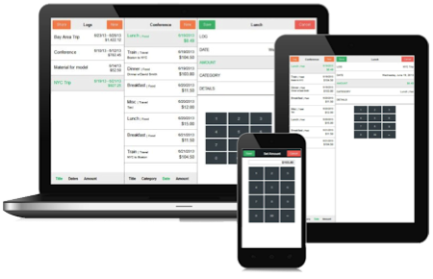
DSE Analytics Reference Architecture
Spark SQL and other goodness
Ops and Developer friendly
Streaming, Hadoop available
No ETL
Cassandra replication
saveToCassandra( )
Replicated, Distributed data
Cache datasets across jobs
Every Analytics node is a worker
True HA without Zookeeper
Master auto-election
Master auto-failover
Single DSE Custer
Your Application
Real Time Operations
Cassandra
Your Analytics
Real Time Replication
Analytics
Queries
Analytics

Slide 3
DSE Analytics Node
Spark and Cassandra
Cassandra
Spark
Data lives in Cassandra
Spark loads data from Cassandra with predicate pushdown
Spark saves data directly to Cassandra tables
Spark Streaming available
memtable A
RDD
memory
storage
sstable A
commit log
Notes:
SSTable = sorted strings table

Slide 4
DSE Streaming Reference Architecture
Single DSE Custer
Streaming
Analytics
Your Application
Message Queue
Batch
Analytics
Real-time

Slide 5
Operations

Slide 6
Getting Started: Pro-Tips
Use appropriate infrastructure
Get your data model right
Know the DataStax driver
Code good query patterns
Size your cluster correctly

Slide 7
Getting Started: Pro-Tips
Use appropriate infrastructure
Get your data model right
Know the DataStax driver
Code good query patterns
Size your cluster correctly
Nodes not too big
Nodes not too small
^ See docs
Avoid shared storage
Physical or virtual are OK

Slide 8
Getting Started: Pro-Tips
Use appropriate infrastructure
Get your data model right
Know the DataStax driver
Code good query patterns
Size your cluster correctly
Denormalize
No RDBMS models
No secondary indexes
Get help if you’re stuck!
Great online resources

Slide 9
Getting Started: Pro-Tips
Use appropriate infrastructure
Get your data model right
Know the DataStax driver
Code good query patterns
Size your cluster correctly
Load balancing/routing
Retry and auto-failover
Session management
Language features

Slide 10
Getting Started: Pro-Tips
Use appropriate infrastructure
Get your data model right
Know the DataStax driver
Code good query patterns
Size your cluster correctly
Asynchronous queries
Prepared statements
Use batches correctly

Slide 11
Getting Started: Pro-Tips
Use appropriate infrastructure
Get your data model right
Know the DataStax driver
Code good query patterns
Size your cluster correctly
Correct number of nodes
Use default heap settings
Always load test

Slide 12
DSE Performance Basics
Can DSE be both bigger and faster? Yes it can.
More Throughput? More Data?
Use more nodes (scale out)
Do not use too big nodes (scale up)
Know Cassandra ops best practices Use OpsCenter to monitor, alert, repair
Faster Operations? Predictable Latency?
Check your data model and queries
Use asynchronous queries
Use prepared statements
Compaction tuning or maybe strategy

Slide 13
Take DataStax Ops Training. It’s Free.
Deploy your cluster correctly
Monitor and alert the right metrics
Use repair correctly
Scale out

Slide 14
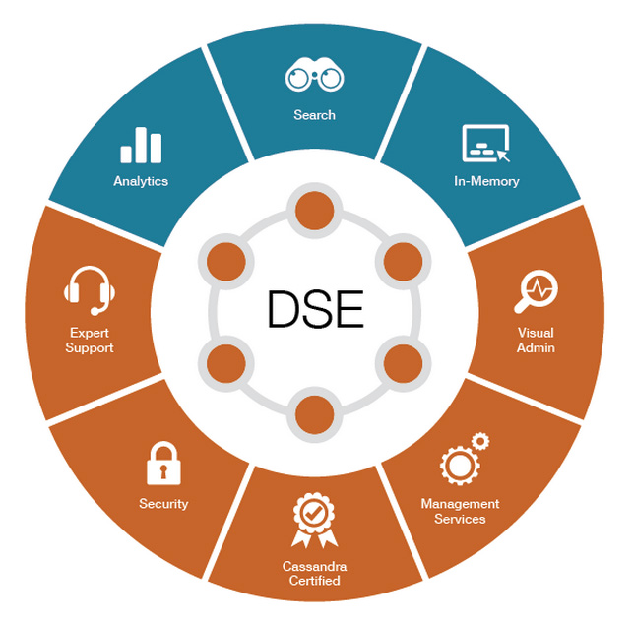
Why DSE Instead of Open Source?
Time to Market
We built the
integrations for you.
Lower TCO
It’s easy to operate.
Open source code
can be painful.

Slide 15
Lab 6 – Analytics Lab 7 – Operations
https://github.com/DSPN/DataStaxDay

